Slide 1

Protocol Vulnerabilities
Protocol Vulnerabilities
Video 7.2

Slide 2
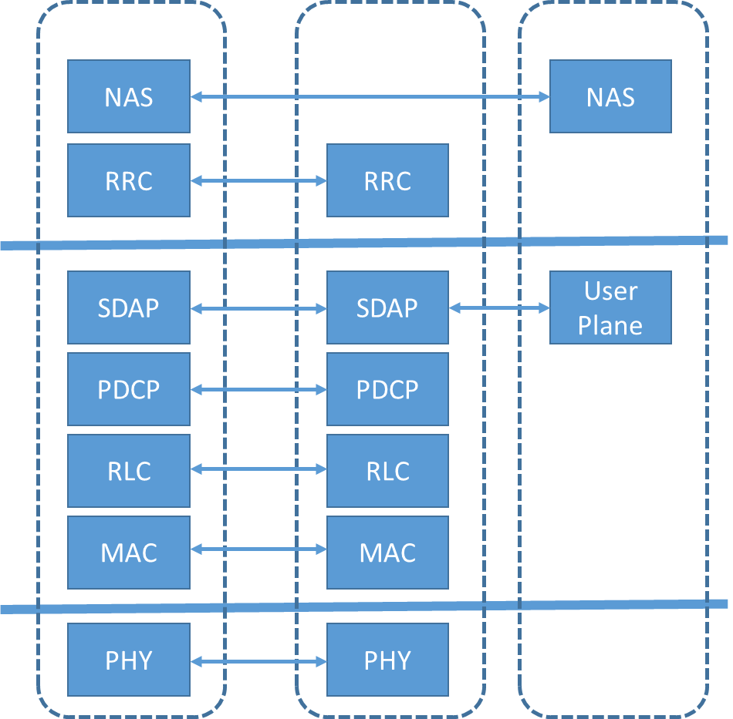
Protocols
Open Systems
Interconnection Layer
Layer 3
Network
NAS: Non-Access Stratum
RRC: Radio Resource Control
SDAP: Service Data Adaptation Protocol
PDCP: Packet Data Convergence Protocol
RLC: Radio Link Control
MAC: Medium Access Control
PHY: Physical
Layer 2
Data
Layer 1
Physical

Slide 3
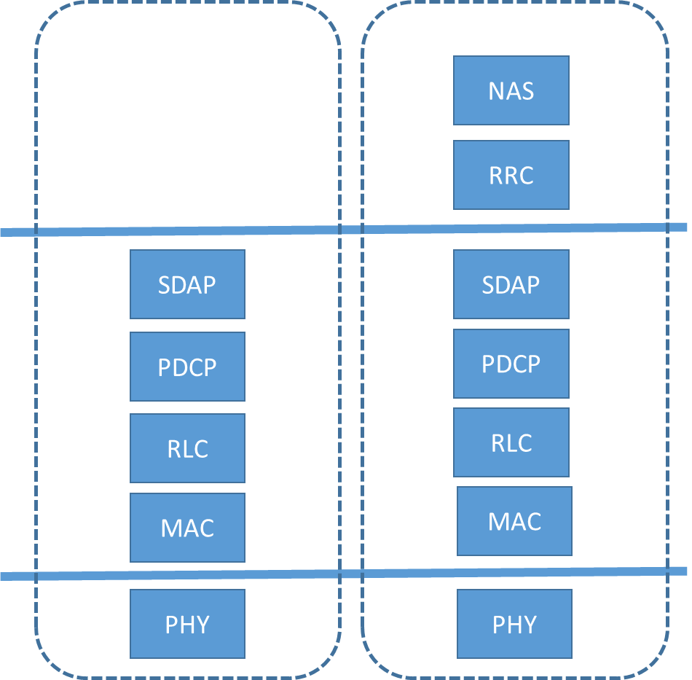
Protocols
Open Systems
Interconnection Layer
User Plane: Exchanges data between Core Network and UE; also called Data Plane.
Layer 3
Network
Control Plane: Sets up and tears down connections, responsible for routing.
NAS: Non-Access Stratum
RRC: Radio Resource Control
SDAP: Service Data Adaptation Protocol
PDCP: Packet Data Convergence Protocol
RLC: Radio Link Control
MAC: Medium Access Control
PHY: Physical
Layer 2
Data
Layer 1
Physical

Slide 4
Protocol Vulnerabilities
5G Networks
Function Security standards recommended or required but not implemented.
Scan Found Vulnerabilities found during function, configuration, or port scans.
Fuzz Discovered Finding defects and abnormal behavior through random and unexpected inputs.
Penetration Approach using holistic knowledge of network, tools, and gaps.

Slide 5
Protocol Vulnerabilities
5G Networks
Examples:
Optional NAS and RRC confidentiality.
Optional UP integrity in some cases.
Mitigation:
Choose highest level ciphering algorithms.
128-NEA-3 for confidentiality.
128-NIA-3 for integrity.
If not possible, send only non-identity related information.
Function Security standards recommended or required but not implemented.

Slide 6
Protocol Vulnerabilities
5G Networks
Examples:
RAN network function configurations.
5G Core network function ports.
Mitigation:
Use commercial products to scan for vulnerabilities.
Take action to mitigate.
Scan Found Vulnerabilities found during function, configuration, or port scans.

Slide 7
Protocol Vulnerabilities
5G Networks
Examples:
Malformed packets through a rogue base station.
IoT manipulation.
Mitigation:
Test networks against vulnerability.
Use scale, load, and performance testing.
Fuzz Discovered Finding defects and abnormal behavior through random and unexpected inputs.

Slide 8
Protocol Vulnerabilities
5G Networks
Examples:
SUPI transmitted without encryption via UE manipulation.
“Bid down” to less secure 4G LTE.
Penetration Approach using holistic knowledge of network, tools, and gaps.
Mitigation:
Hire experts to conduct “white hat” testing.
Train and utilize Security Operations team.

Slide 9
Key Takeaways
01
Protocol Ciphering Can Be Optional
Should try to avoid these, if possible.
02
Vulnerabilities Exist
Function, Scan, Fuzz, and Penetration.
03
Mitigation is Possible
Acknowledge and act.

Slide 10
AKA Attacks
Next Video

